Slide 1


High Altitude Balloon Data Logger for Scientific Payloads
Presented by: Dallas Hodge
Spring 2014
2014 Space Grant Symposium

Slide 2
Outline
Background motivation
Conceptual design
Detail design elements
Implementation
Flight results
Ultimate outcome

Slide 3
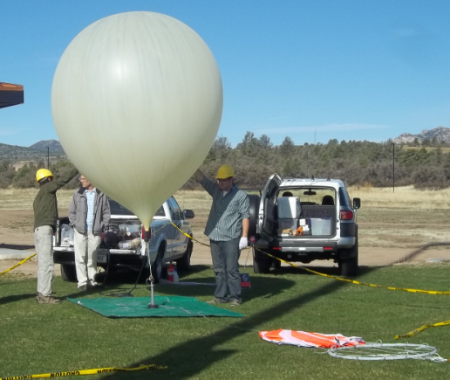
Background
Embry-Riddle supports the Arizona Near Space Research (ANSR) organization
Student teams routinely launch
experimental payloads
into near space
Typical altitude
of 100,000 feet above sea
level

Slide 4
Background Continued
Balloon burst
Pop
3
2
Slow ascent
Parachute descent
4
5
Recovery
Fill balloon and launch
1

Slide 5
Project Motivation
Need expressed for a simple kit or pre-assembled data logger which accomplishes:
Electrical/computer engineering summer camp 2013
Introduction to applied electronics
Simple sensor instrumentation exposure
Reliably collect and save data to a removable memory element

Slide 6
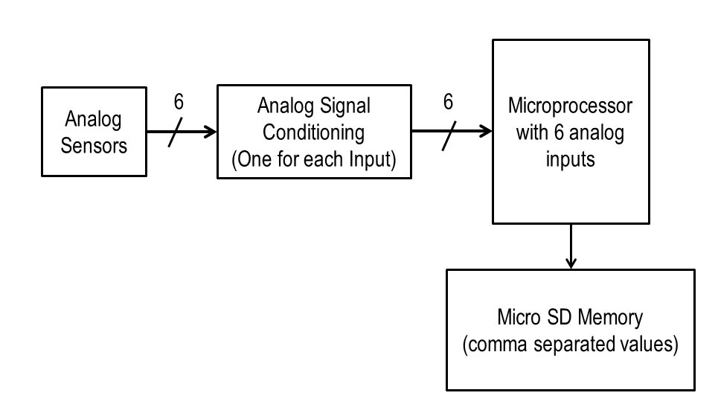
Conceptual Design
Composed of microcontroller with input signal conditioning and data storage to an SD card

Slide 7
Preliminary Design
Atmega328 microcontroller and Arduino development environment selected.
Difference op-amp for analog signal conditioning
Status indicator LED
Press button for ending data saving upon payload recovery
Minimize risk of data loss due to system upset

Slide 8
Project Development
Build a little, test a little
Subsystems were built up on a breadboard and verified:
Microcontroller and micro SD card interface
Power supply unit
Op-amp signal conditioning
Circuit simulation

Slide 9
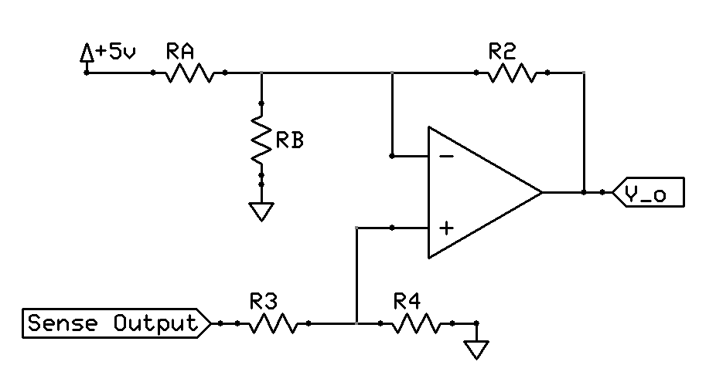
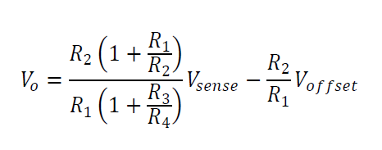
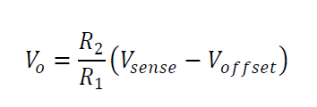
Difference Amplifier
Signal shifting and scaling from sensor input to op-amp output

Slide 10
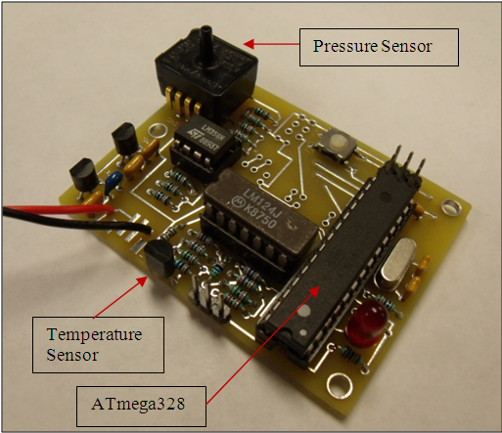
Implementation
Compact through-hole part solution for ease of student assembly
Instructions provide desired level of detail behind understanding the principle of operation
Prototype tested over temperature, pressure, and time

Slide 11
Usage
Data loggers initially developed for summer camp
Data loggers are now an education outreach program feature where surrounding schools learn about the device and fly with ANSR
Original design intent of providing practical electronics exposure to high school and middle school students

Slide 12
Flight Results

Slide 13
Flight Results

Slide 14
Project Outcomes
Embry-Riddle continues to support STEM outreach by offering the use of the data logger
Practical electronics design work including:
System engineering
Product development management
Printed circuit board layout skills
Laboratory testing, troubleshooting, and documentation

Slide 15
Questions

